Slide 1
Group B/D Project Python Training
Focus on Complex Structures and Handling Data with Pandas

Slide 2
Agenda
First Half (Python Basics):
What is a programming language?
Why Python?
Introduction to Jupyter Notebooks:
Principles.
How to use and its commands.
Lists, Tuples, and Dictionaries.
Introduction to Libraries and Import.

Slide 3
Agenda
Second Half (Data Manipulation):
What is Pandas?
What are DataFrames and Series?
read_ function
How to handle your DataFrame.
loc, iloc, rename, drop, merge, concat, join
GroupBy
Looping Through DataFrames
to_ function

Slide 4

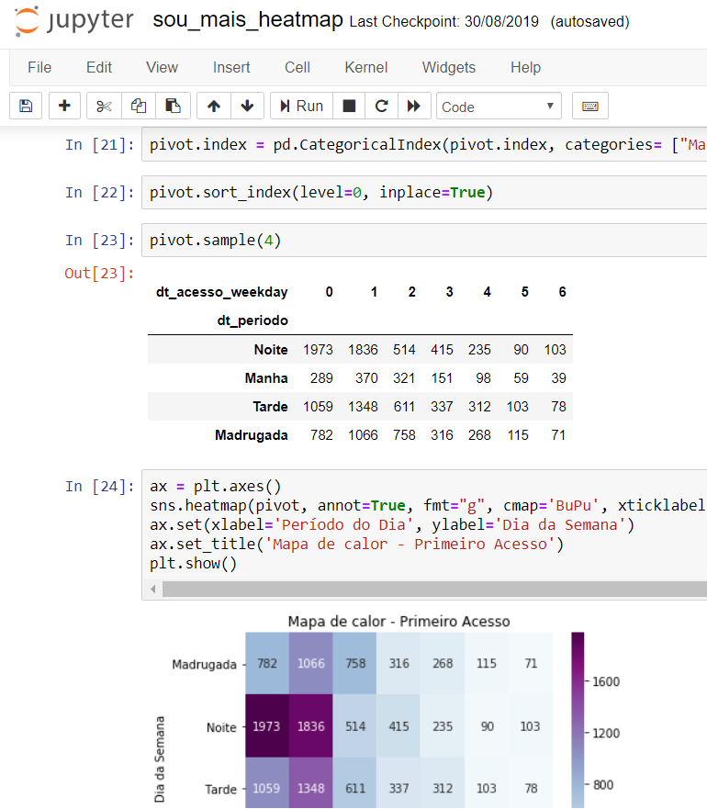
Jupyter Notebooks

